Slide 2
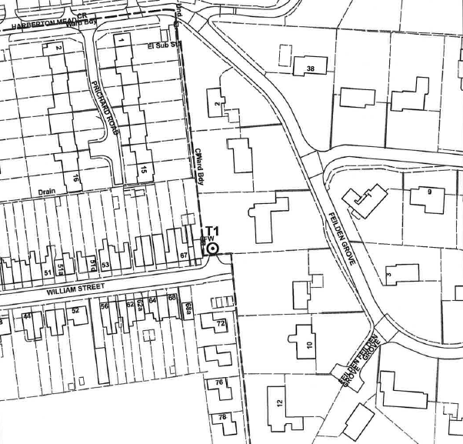
Site Plan

Slide 3
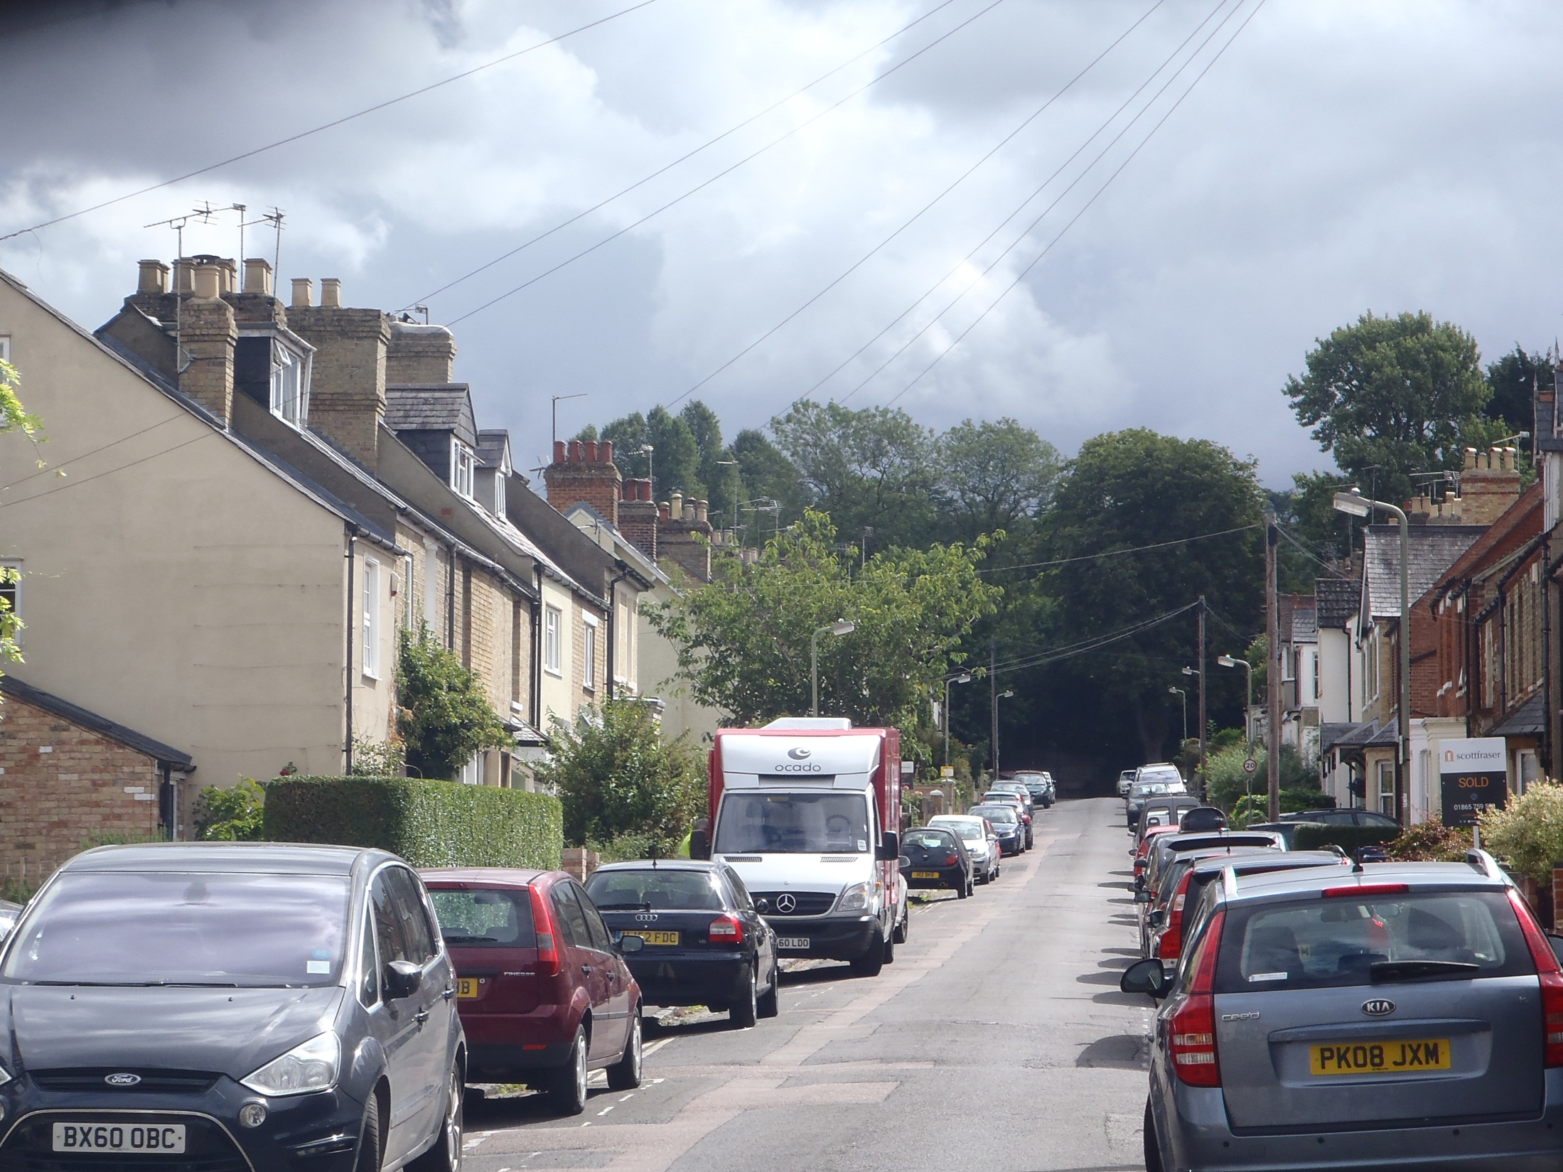
T1
Photo 1: View looking east up William Street (far view).

Slide 4
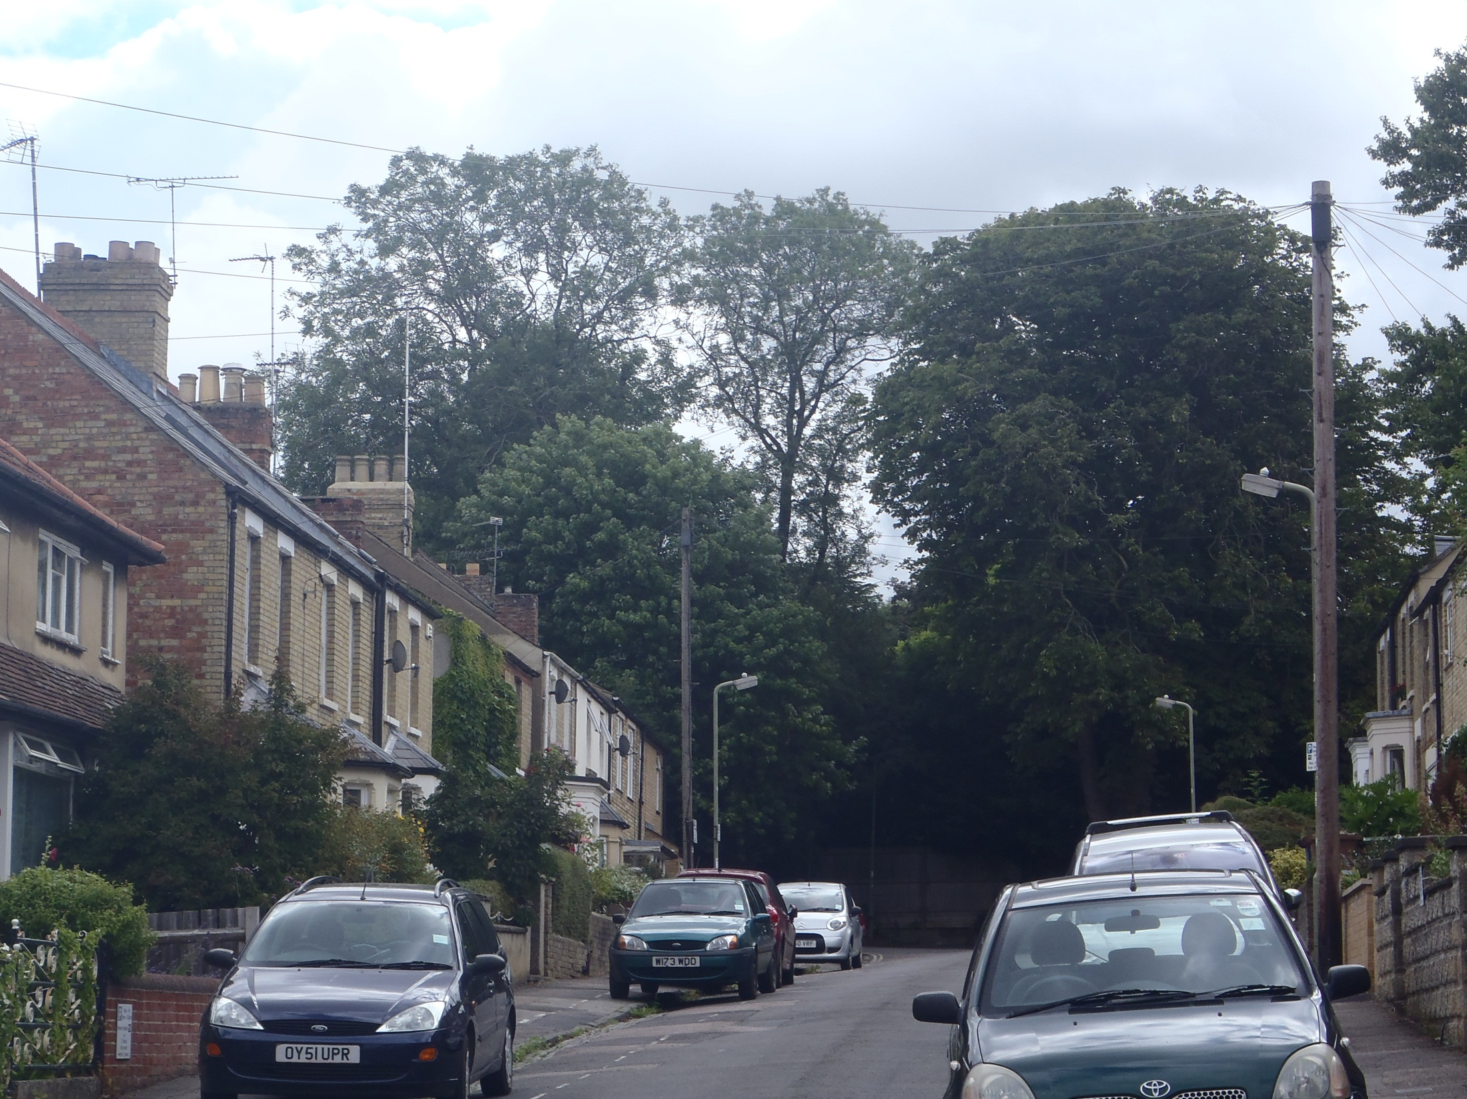
T1
Photo 2: View looking east up William Street (near view).

Slide 5
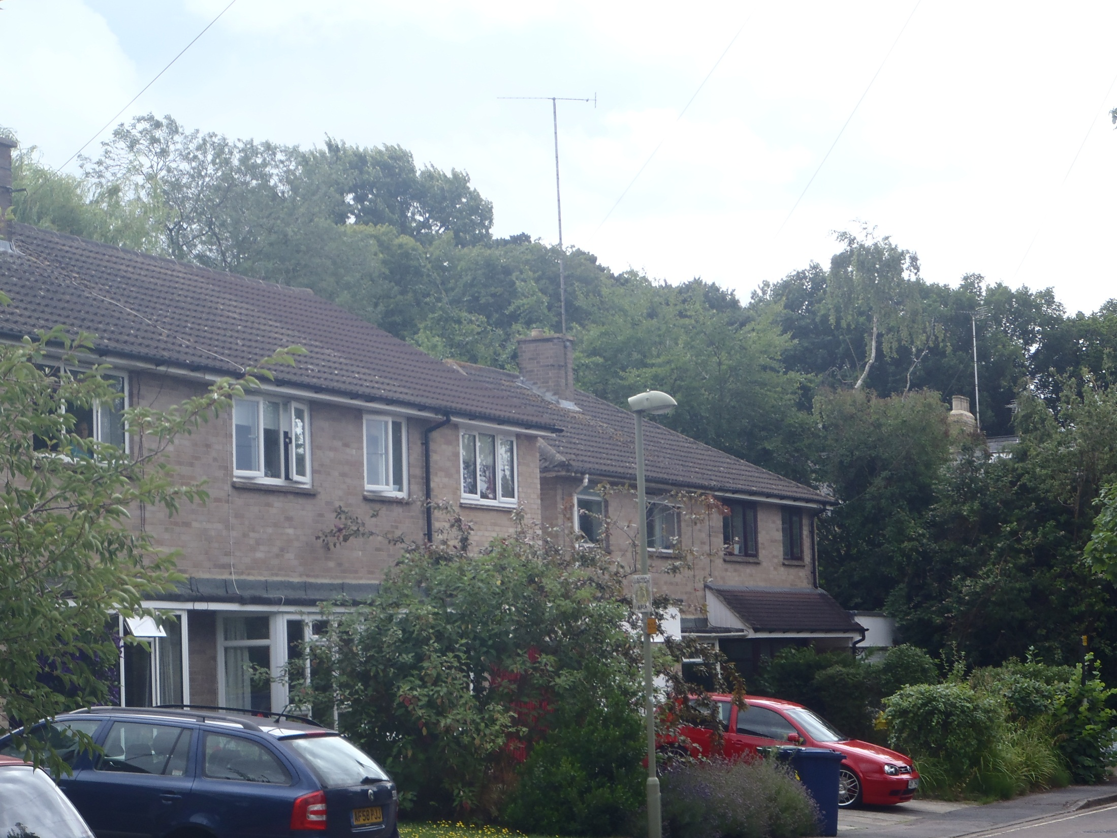
T1
Photo 3: View looking south east along Prichard Road.

Slide 6
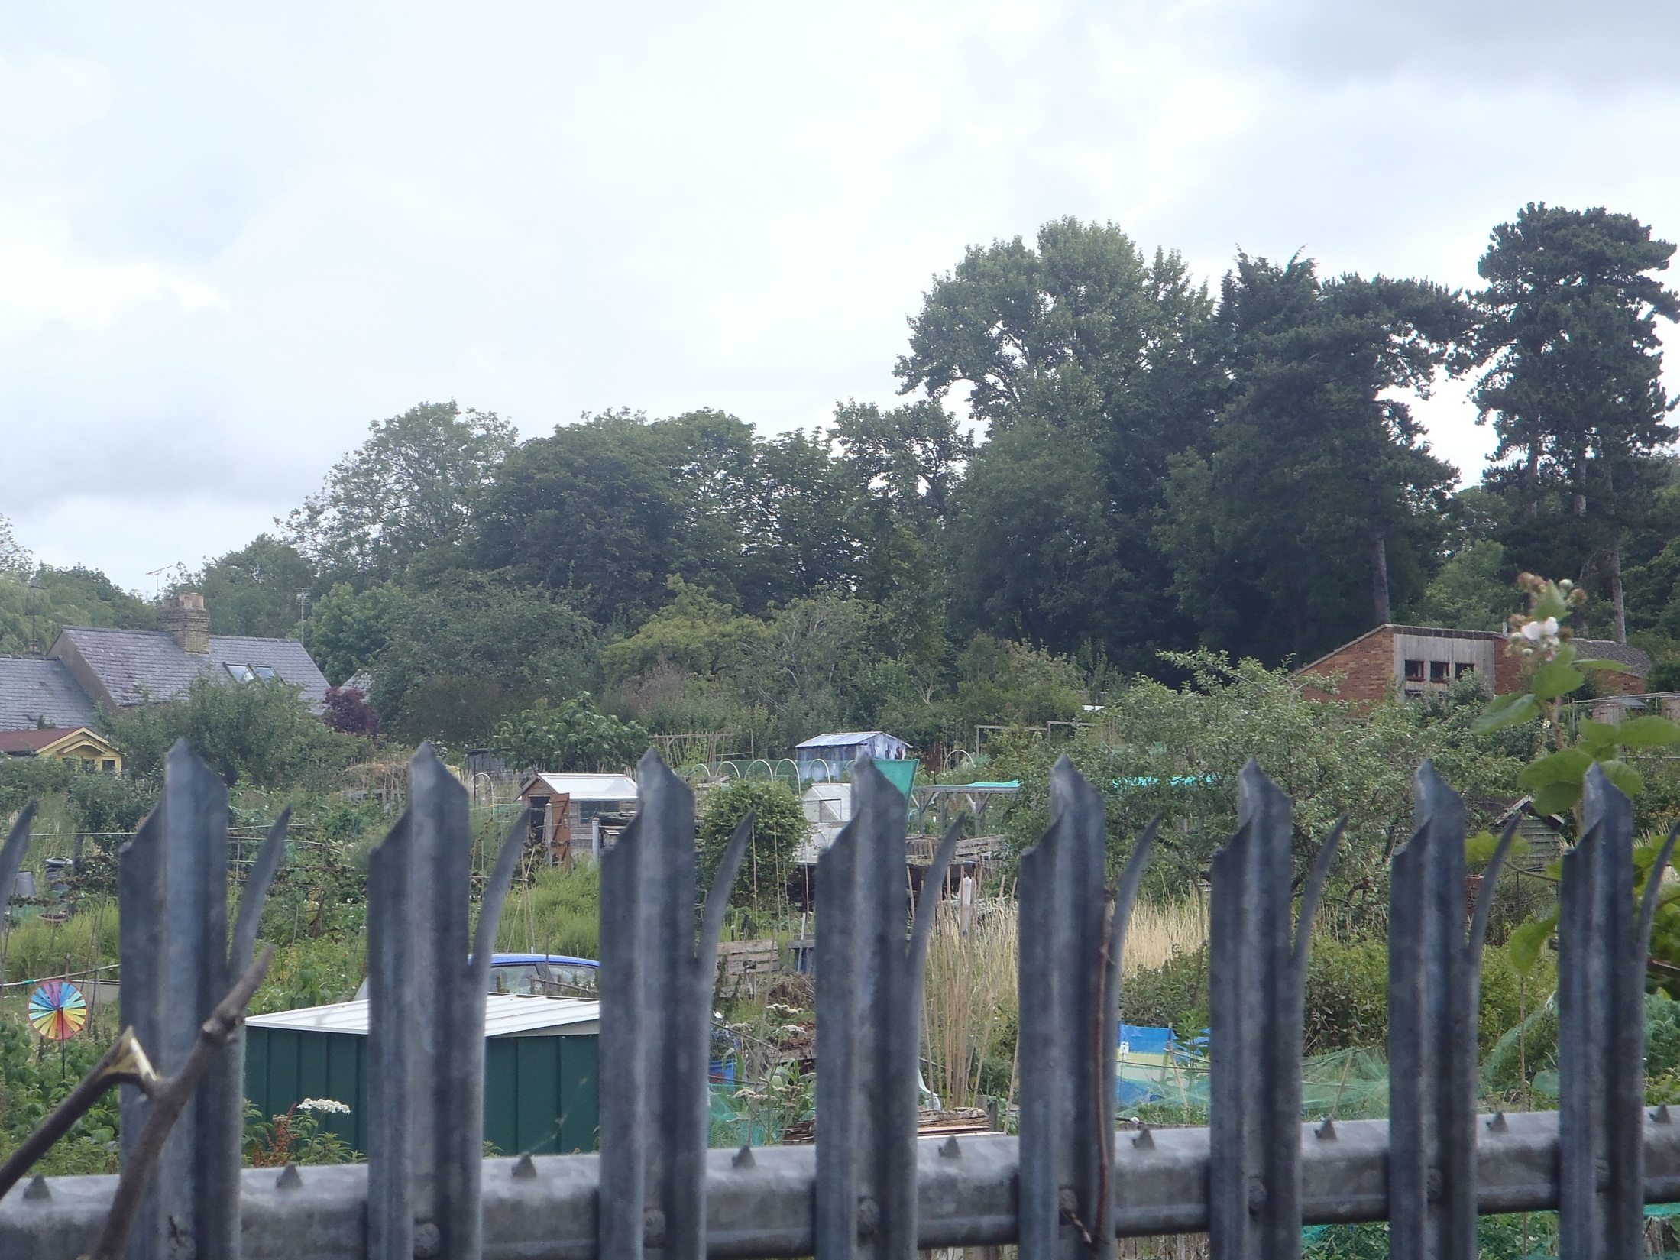
T1
Photo 4: View looking north east from Garne Way.

Slide 7
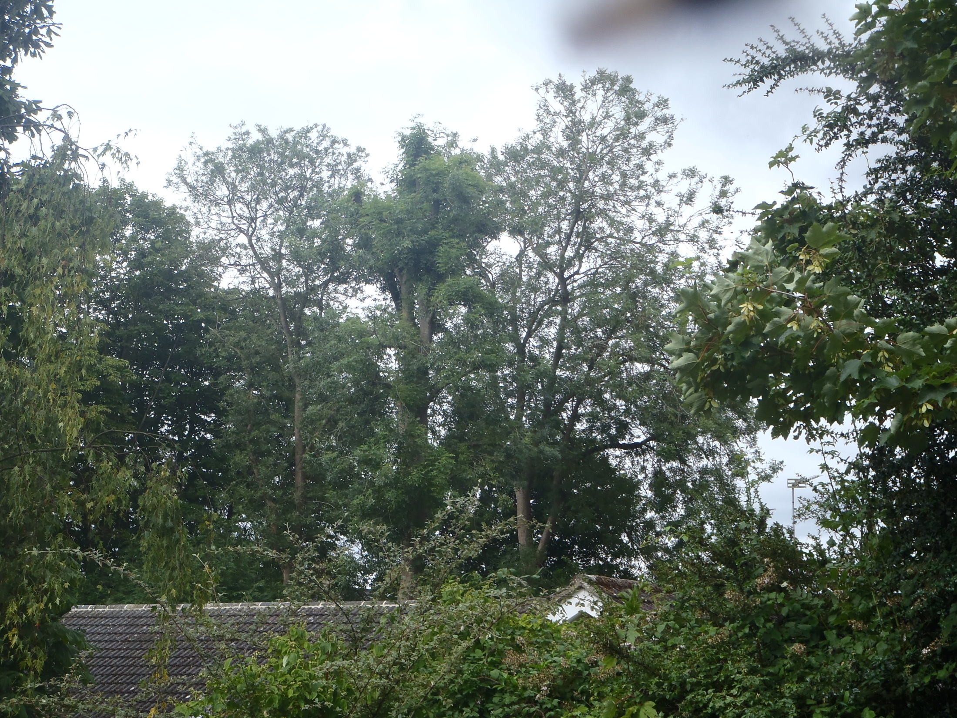
Ta
T1
Photo 5: View looking west over No 6 from Fielden Grove

